Slide 1




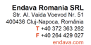
Basic C# part 2
Teodora Berende
Proiect cofinantat din Fondul Social European prin Programul Operational Capital Uman 2014-2020

Slide 2


AGENDA
Conditional statements
If/Else
For
While & Do-While
Most used functions in C#
Conversion of datatypes
Boxing and Unboxing
Proiect cofinantat din Fondul Social European prin Programul Operational Capital Uman 2014-2020

Slide 3

IF / ELSE
Proiect cofinantat din Fondul Social European prin Programul Operational Capital Uman 2014-2020

Slide 4
IF / ELSE
if (condition)
{
// do something
}
else
{
//do other stuff
}
if (condition_1)
{
// do something
}
else if (condition_2)
{
// do something_2
}
else
{
//do other stuff
}
if (condition)
{
// do something
}
Proiect cofinantat din Fondul Social European prin Programul Operational Capital Uman 2014-2020

Slide 5

FOR
Proiect cofinantat din Fondul Social European prin Programul Operational Capital Uman 2014-2020

Slide 6
FOR
for (int i=0; i<n; i++)
{
// do something
}
List<int> numbers = new List<int> { 1, 2, 3 };
foreach(var number in numbers)
{
// do something
}
Proiect cofinantat din Fondul Social European prin Programul Operational Capital Uman 2014-2020

Slide 7
Practice TIME
IF/ELSE & FOR
Proiect cofinantat din Fondul Social European prin Programul Operational Capital Uman 2014-2020

Slide 8

WHILE & DO-WHILE
Proiect cofinantat din Fondul Social European prin Programul Operational Capital Uman 2014-2020

Slide 9
WHILE & DO-WHILE
while (condition)
{
// do something
}
do
{
// something
}while(condition);
Proiect cofinantat din Fondul Social European prin Programul Operational Capital Uman 2014-2020

Slide 10
WHILE vs DO-WHILE
Use while when you want to check the condition first.
It is an entry-controlled loop.
Use do-while when you want to run your code at least once. The condition is checked after the code is executed.
It is an exit-controlled loop.
Proiect cofinantat din Fondul Social European prin Programul Operational Capital Uman 2014-2020

Slide 11
Practice TIME
WHILE & DO-WHILE
Proiect cofinantat din Fondul Social European prin Programul Operational Capital Uman 2014-2020

Slide 12
Most Used Functions
ToString()
ToUpper()/ToLower()
Math.Max()/Math.Min()
Proiect cofinantat din Fondul Social European prin Programul Operational Capital Uman 2014-2020

Slide 13
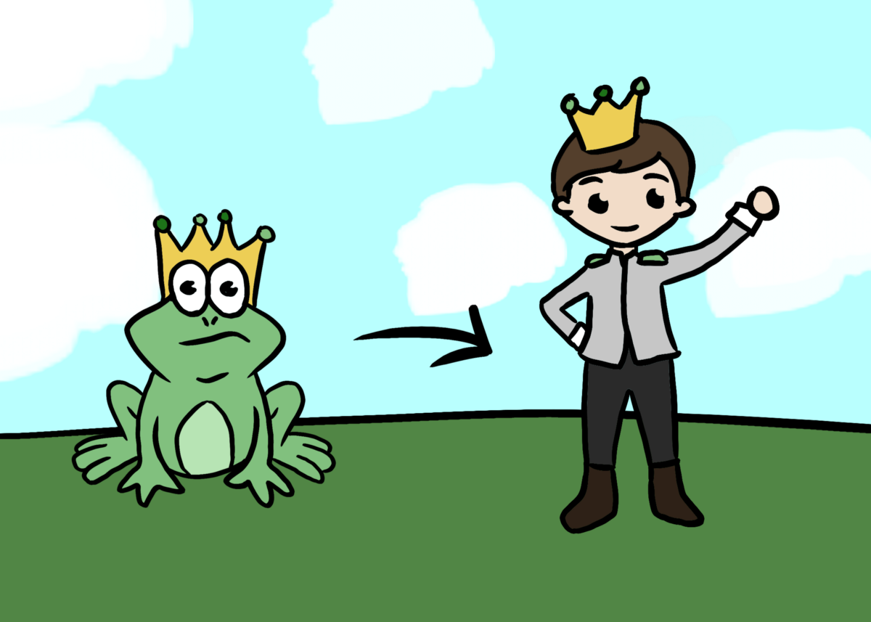
Conversion Of Datatypes
Proiect cofinantat din Fondul Social European prin Programul Operational Capital Uman 2014-2020

Slide 14
Practice TIME
Most Used Functions
Conversion Of Datatypes
Proiect cofinantat din Fondul Social European prin Programul Operational Capital Uman 2014-2020

Slide 15
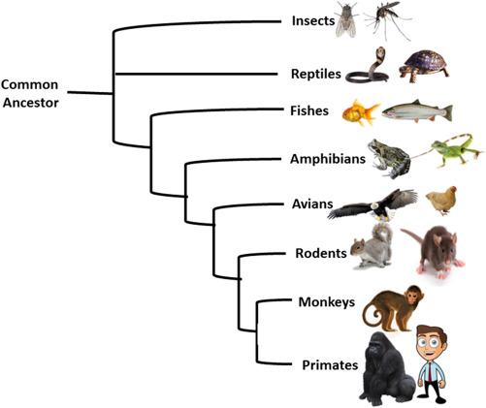
Object class
Proiect cofinantat din Fondul Social European prin Programul Operational Capital Uman 2014-2020

Slide 16
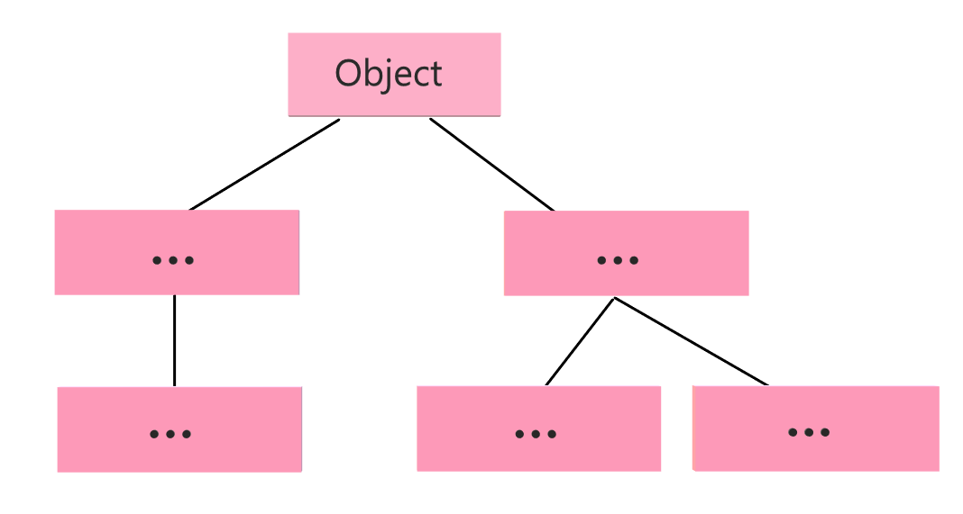
Object class
Proiect cofinantat din Fondul Social European prin Programul Operational Capital Uman 2014-2020

Slide 17

Boxing & Unboxing
Proiect cofinantat din Fondul Social European prin Programul Operational Capital Uman 2014-2020

Slide 18
BOXING
UNBOXING
Converts any object to the Object class.
Implicit conversion.
Unboxing extracts the value type from the object.
Explicit conversion.
Both are expensive operations!
Proiect cofinantat din Fondul Social European prin Programul Operational Capital Uman 2014-2020

Slide 19
Practice TIME
Boxing & Unboxing
Proiect cofinantat din Fondul Social European prin Programul Operational Capital Uman 2014-2020

Slide 20
Q&A
Proiect cofinantat din Fondul Social European prin Programul Operational Capital Uman 2014-2020

Slide 21

THANK YOU
Teodora Berende
teodoraemilia.berende@endava.com
Proiect cofinantat din Fondul Social European prin Programul Operational Capital Uman 2014-2020

